Slide 1
What did Jesus Say?

Slide 2
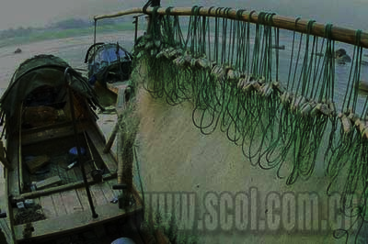

Slide 3
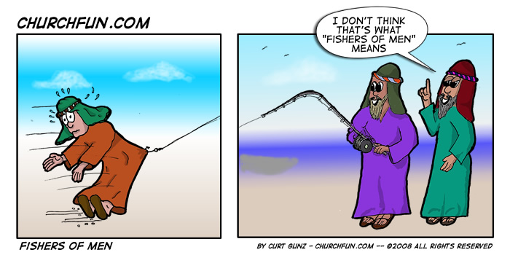

Slide 4
Repent
Μετανοέω metanoeō met-an-o-eh'-o
to think differently or afterwards, that is, reconsider :- repent.
Thayer Definition:
1) to change one’s mind, i.e. to repent
2) to change one’s mind for better, heartily to amend with abhorrence of one’s past sins

Slide 5
Ezekiel 18:30-32 ³⁰ "Therefore, O house of Israel, I will judge you, each one according to his ways, declares the Sovereign LORD. Repent! Turn away from all your offenses; then sin will not be your downfall. ³¹ Rid yourselves of all the offenses you have committed, and get a new heart and a new spirit. Why will you die, O house of Israel? ³² For I take no pleasure in the death of anyone, declares the Sovereign LORD. Repent and live!

Slide 6
Luke 5:31-32 ³¹ Jesus replied to them, "The healthy don't need a doctor, but the sick do. ³² I have not come to call the righteous, but sinners to repentance."

Slide 7
Romans 5:12 Therefore, just as sin entered the world through one man, and death through sin, in this way death spread to all men, because all sinned.

Slide 8
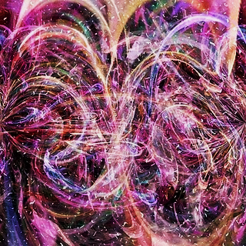
Luke 15:10 ¹⁰ I tell you, in the same way, there is joy in the presence of God's angels over one sinner who repents."

Slide 9
Acts 2:38 ³⁸ "Repent," Peter said to them, "and be baptized, each of you, in the name of Jesus the Messiah for the forgiveness of your sins, and you will receive the gift of the Holy Spirit.
2 Corinthians 5:17 Therefore, if anyone is in Christ, he is a new creation; old things have passed away; behold, all things have become new.

Slide 10
The Kingdom of Heaven

Slide 11
The Kingdom of Heaven
Eternal – because God is eternal.
Psalm 145:13 Your kingdom is an everlasting kingdom; Your rule is for all generations

Slide 12
The Kingdom of Heaven
Eternal – because God is eternal.
Psalm 145:13 Your kingdom is an everlasting kingdom; Your rule is for all generations
Universal – because God is omnipresent – present everywhere.
Psalm 103:19 The LORD has established His throne in heaven, and His kingdom rules over all.
Dan 4:17 the Most High is sovereign over the kingdoms of men and gives them to anyone he wishes

Slide 13
The Kingdom of Heaven
Eternal – because God is eternal.
Psalm 145:13 Your kingdom is an everlasting kingdom; Your rule is for all generations
Universal – because God is omnipresent – present everywhere.
Psalm 103:19 The LORD has established His throne in heaven, and His kingdom rules over all.
Dan 4:17 the Most High is sovereign over the kingdoms of men and gives them to anyone he wishes
Supernatural - God demonstrates His authority and His power in His kingdom.
Psalm 135:6 The LORD does whatever He pleases in heaven and on earth, in the seas and all the depths. ⁷ He causes the clouds to rise from the ends of the earth. He makes lightning for the rain and brings the wind from His storehouses. ⁸ He struck down the firstborn of Egypt, both people and animals. ⁹ He sent signs and wonders against you, Egypt, against Pharaoh and all his officials. ¹⁰ He struck down many nations and slaughtered mighty kings: 12 He gave their land as an inheritance, an inheritance to His people Israel.

Slide 14
1 Samuel 8:6: When they said, "Give us a king to judge us," Samuel considered their demand sinful, so he prayed to the LORD. ⁷ But the LORD told him, "Listen to the people and everything they say to you. They have not rejected you; they have rejected Me as their king.

Slide 15
Isaiah 14:13-14 You said in your heart, "I will ascend to heaven; I will raise my throne above the stars of God; I will sit enthroned on the mount of assembly, on the utmost heights of the sacred mountain. ¹⁴ I will ascend above the tops of the clouds; I will make myself like the Most High."

Slide 16
^{The Kingdom of Satan}
has Satan as the ‘king’
Ephesians 2:2 “ the ruler of the kingdom of the air, the spirit who is now at work in those who are disobedient.

Slide 17
^{The Kingdom of Satan}
has Satan as the ‘king’
Ephesians 2:2 “ the ruler of the kingdom of the air, the spirit who is now at work in those who are disobedient.
has fallen angels as subjects
Revelation 12:9 So the great dragon was thrown out-- the ancient serpent, who is called the Devil and Satan, the one who deceives the whole world. He was thrown to earth, and his angels with him.

Slide 18
^{The Kingdom of Satan}
has Satan as the ‘king’
Ephesians 2:2 “ the ruler of the kingdom of the air, the spirit who is now at work in those who are disobedient.
has fallen angels as subjects
Revelation 12:9 So the great dragon was thrown out-- the ancient serpent, who is called the Devil and Satan, the one who deceives the whole world. He was thrown to earth, and his angels with him.
has access to the whole world
1 John 5:19 ¹⁹ the whole world is under the control of the evil one.-

Slide 19
^{The Kingdom of Satan}
has Satan as the ‘king’
Ephesians 2:2 “ the ruler of the kingdom of the air, the spirit who is now at work in those who are disobedient.
has fallen angels as subjects
Revelation 12:9 So the great dragon was thrown out-- the ancient serpent, who is called the Devil and Satan, the one who deceives the whole world. He was thrown to earth, and his angels with him.
has access to the whole world
1 John 5:19 ¹⁹ the whole world is under the control of the evil one.-
is a kingdom of darkness, disobedience, deceit and opposition to God.
Col. 1:13, Eph. 2:2, Rev. 13:14. 2 Thess. 2:4

Slide 20
Matthew 4:16-17 ¹⁶ the people living in darkness have seen a great light; on those living in the land of the shadow of death a light has dawned." ¹⁷ From that time on Jesus began to preach, "Repent, for the kingdom of heaven is near.“

Slide 21
Ephesians 1:19-22 ²⁰ which he exerted in Christ when he raised him from the dead and seated him at his right hand in the heavenly realms, ²¹ far above all rule and authority, power and dominion, and every title that can be given, not only in the present age but also in the one to come. ²² And God placed all things under his feet and appointed him to be head over everything for the church,
Ephesians 1:3-4 ³ Praise be to the God and Father of our Lord Jesus Christ, who has blessed us in the heavenly realms with every spiritual blessing in Christ. ⁴ For he chose us in him before the creation of the world to be holy and blameless in his sight.

Slide 22
Colossians 1:12-14 ¹² giving thanks to the Father, who has qualified you to share in the inheritance of the saints in the kingdom of light. ¹³ For he has rescued us from the dominion of darkness and brought us into the kingdom of the Son he loves, ¹⁴ in whom we have redemption, the forgiveness of sins.

Slide 23
Follow Him
responded to a person

Slide 24
Follow Him
responded to a person
leave stuff behind

Slide 25
Follow Him
responded to a person
leave stuff behind
day by day

Slide 26
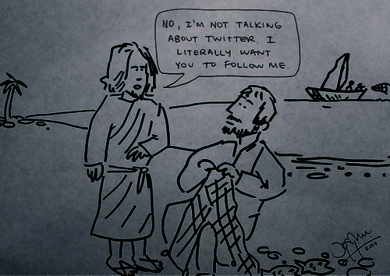
Follow Him
responded to a person
leave stuff behind
day by day

