Slide 1
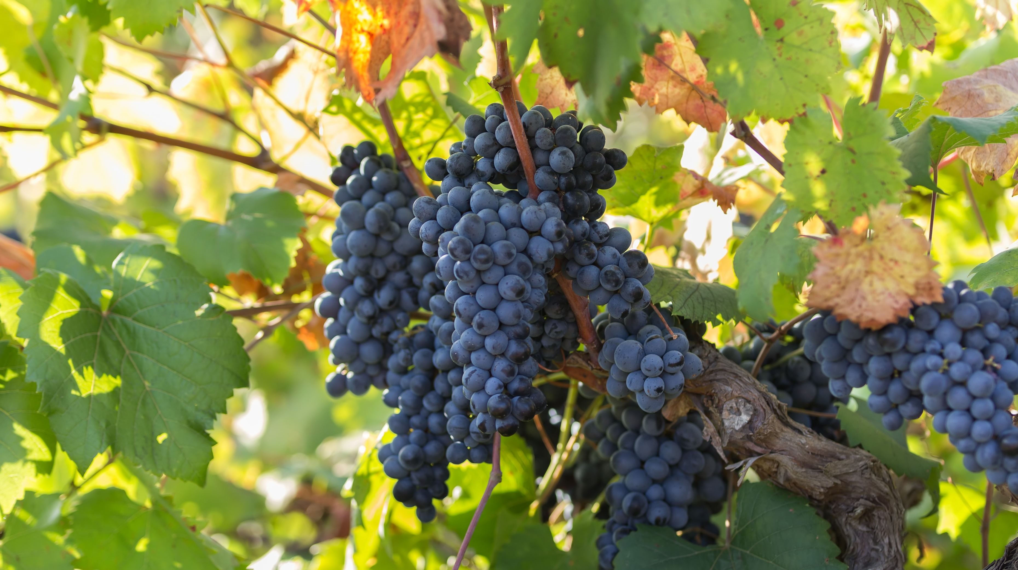
Abide in Me
Devotion and Dependence on Jesus Christ
John 14 - 16

Slide 2
Abide in Me
 Fruitful year 
 Familiar Verses 
 Grow in Faith 
 Fellowship with each other 

Slide 3
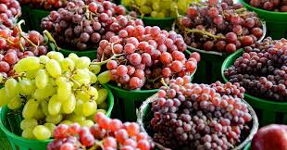
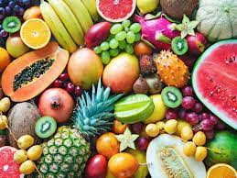
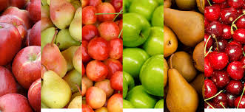
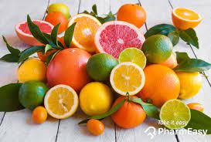
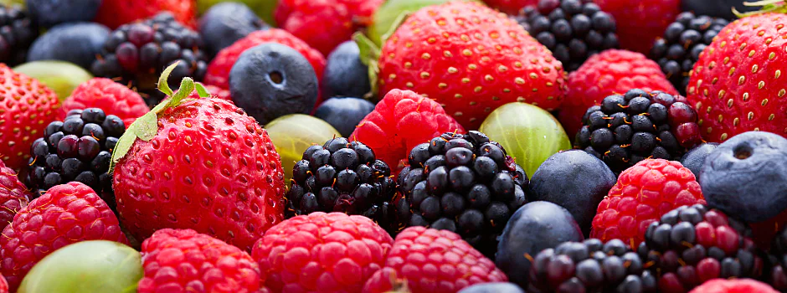
 Fruitful year 
Galatians 5:22-23 But the fruit of the Spirit is love, joy, peace, patience, kindness, goodness, faithfulness, gentleness, self-control; against such things there is no law.

Slide 4
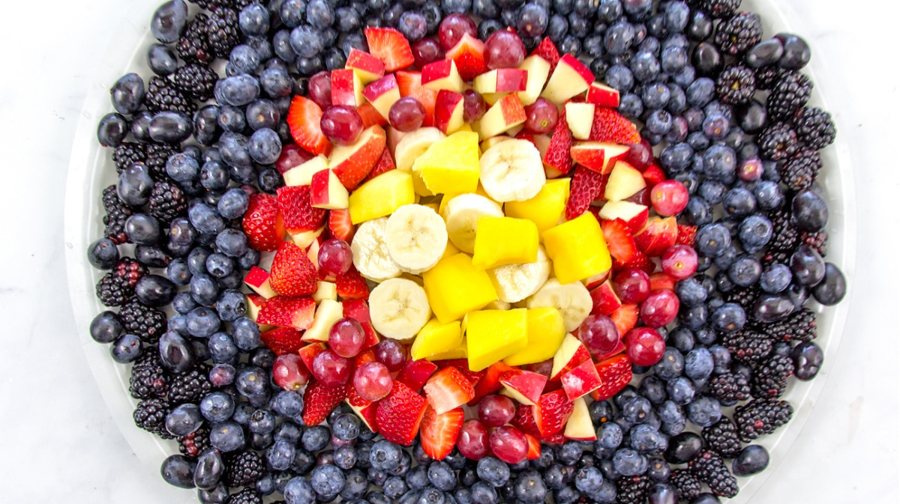
LOVE!
GOODNESS!
FAITHFULNESS!
JOY!
Fruit of the Spirit!
PEACE!
GENTLENESS!
PATIENCE!
SELF-
CONTROL!
KINDNESS!

Slide 5
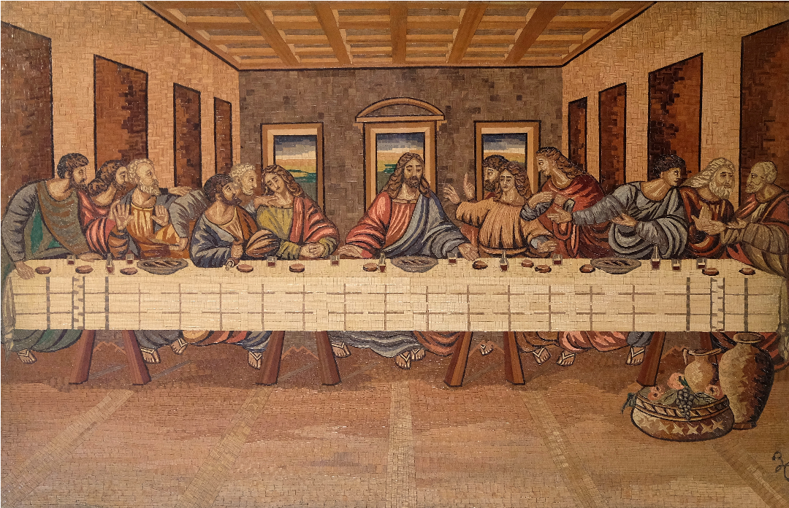

Slide 6
Vine & Branches
Illustration
John 15:1-25

Slide 7
Foot – washing John 13:1-38
Vine & Branches
Illustration
John 15:1-25

Slide 8
 Fruitful year 
John 13:3-5 ³ Jesus, knowing that the Father had given all things into his hands, and that he had come from God and was going back to God, ⁴ rose from supper. He laid aside his outer garments, and taking a towel, tied it around his waist. ⁵ Then he poured water into a basin and began to wash the disciples' feet and to wipe them with the towel that was wrapped around him.

Slide 9
Foot – washing John 13:1-38
Vine & Branches
Illustration
John 15:1-25
Jesus’ Prayer John 17:1-26

Slide 10
 Fruitful year 
John 17:25-26 O righteous Father, even though the world does not know you, I know you, and these know that you have sent me. ²⁶ I made known to them your name, and I will continue to make it known, that the love with which you have loved me may be in them, and I in them.

Slide 11
Foot – washing John 13:1-38
Loneliness and Anxiety John 14:1-14
Vine & Branches
Illustration
John 15:1-25
Loneliness and Anxiety John 16:16-33
Jesus’ Prayer John 17:1-26

Slide 12
 Fruitful year 
John 14:1-3 Let not your hearts be troubled. Believe in God; believe also in me. ² In my Father's house are many rooms. If it were not so, would I have told you that I go to prepare a place for you? ³ And if I go and prepare a place for you, I will come again and will take you to myself, that where I am you may be also.

Slide 13
 Fruitful year 
John 16:20 Truly, truly, I say to you, you will weep and lament, but the world will rejoice. You will be sorrowful, but your sorrow will turn into joy.
John 16:33 I have said these things to you, that in me you may have peace. In the world you will have tribulation. But take heart; I have overcome the world.

Slide 14
Foot – washing John 13:1-38
Loneliness and Anxiety John 14:1-14
HOLY SPIRIT John 14:15-31
Vine & Branches
Illustration
John 15:1-25
HOLY SPIRIT John 15:26-16:15
Loneliness and Anxiety John 16:16-33
Jesus’ Prayer John 17:1-26

Slide 15
 Fruitful year 
John 14:16-18 ¹⁶ And I will ask the Father, and he will give you another Helper,¹ to be with you forever, ¹⁷ even the Spirit of truth, whom the world cannot receive, because it neither sees him nor knows him. You know him, for he dwells with you and will be in you. ¹⁸ "I will not leave you as orphans; I will come to you.

Slide 16
 Fruitful year 
John 16:6-8 But because I have said these things to you, sorrow has filled your heart. ⁷ Nevertheless, I tell you the truth: it is to your advantage that I go away, for if I do not go away, the Helper will not come to you. But if I go, I will send him to you. ⁸ And when he comes, he will convict the world concerning sin and righteousness and judgment.

Slide 17
Foot – washing John 13:1-38
Loneliness and Anxiety John 14:1-14
HOLY SPIRIT John 14:15-31
Vine & Branches
Illustration
John 15:1-25
HOLY SPIRIT John 15:26-16:15
Loneliness and Anxiety John 16:16-33
Jesus’ Prayer John 17:1-26

Slide 18
 Fruitful year 
John 15:4-5 Abide in me, and I in you. As the branch cannot bear fruit by itself, unless it abides in the vine, neither can you, unless you abide in me. ⁵ I am the vine; you are the branches. Whoever abides in me and I in him, he it is that bears much fruit, for apart from me you can do nothing.

Slide 19
 Fruitful year 
John 15:16-17 You did not choose me, but I chose you and appointed you that you should go and bear fruit and that your fruit should abide, so that whatever you ask the Father in my name, he may give it to you. ¹⁷ These things I command you, so that you will love one another.

Slide 20
Foot – washing John 13:1-38
Loneliness and Anxiety John 14:1-14
Paraclete John 14:15-31
Vine & Branches
Illustration
John 15:1-25
Paraclete John 15:26-16:15
Loneliness and Anxiety John 16:16-33
Jesus’ Prayer John 17:1-26

Slide 21
 Fruitful year 
What kind of fruit are you??!!

Slide 22
 Fruitful year 
Leaders:
Chrissy Morton - 205
Grace Bridges - 203
Michele Daum - 204
Michelle Murray – 202A

Slide 23


Slide 24
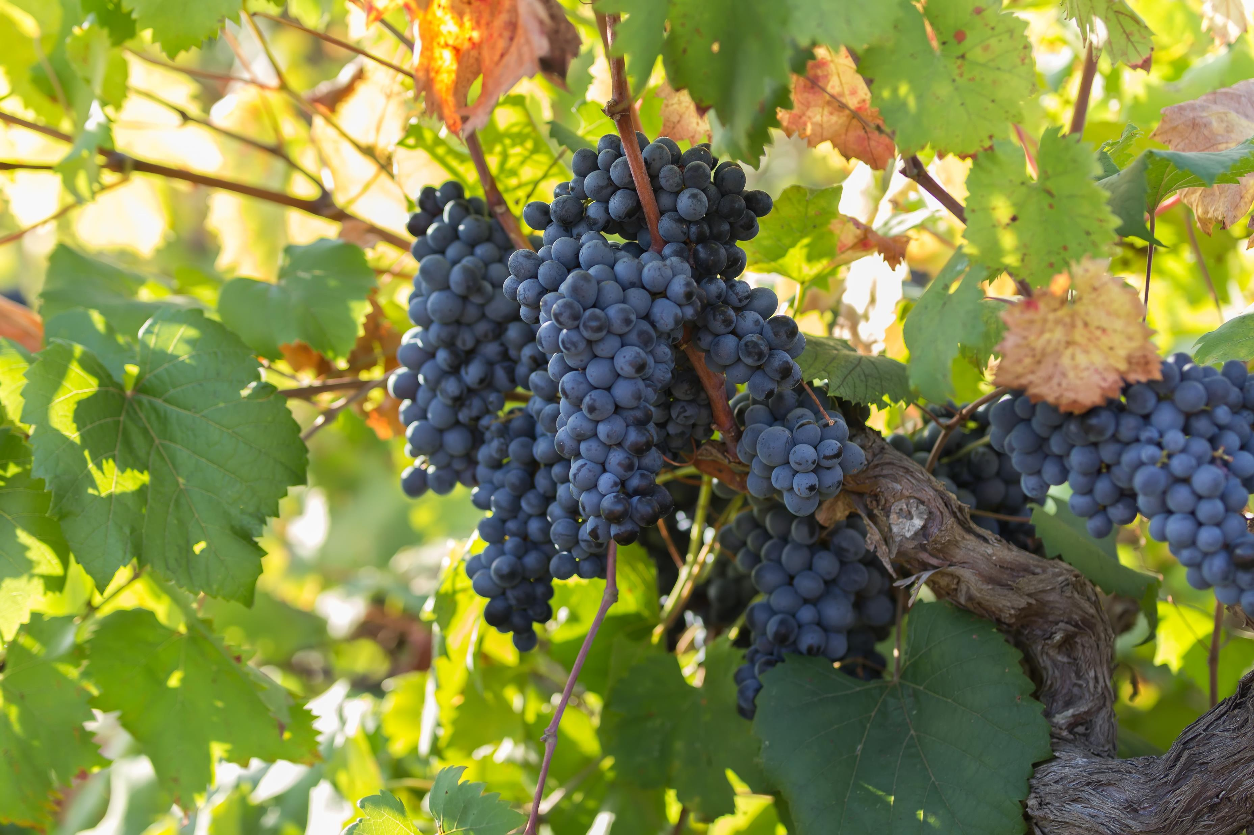
Abide in Me:
Devotion and Dependence on Jesus Christ
fruitful year,
Familiar verses
grow in Faith
Fellowship with each other

Slide 25
 Fruitful year 
Galatians 5:22-23 But the fruit of the Spirit is love, joy, peace, patience, kindness, goodness, faithfulness, gentleness, self-control; against such things there is no law.

Slide 26
 Fruitful year 
Galatians 5:22-23 But the fruit of the Spirit is love, joy, peace, patience, kindness, goodness, faithfulness, gentleness, self-control; against such things there is no law.

